Slide 1
Manteca Traffic Calming Program 2025 Citywide Guidelines

Slide 2
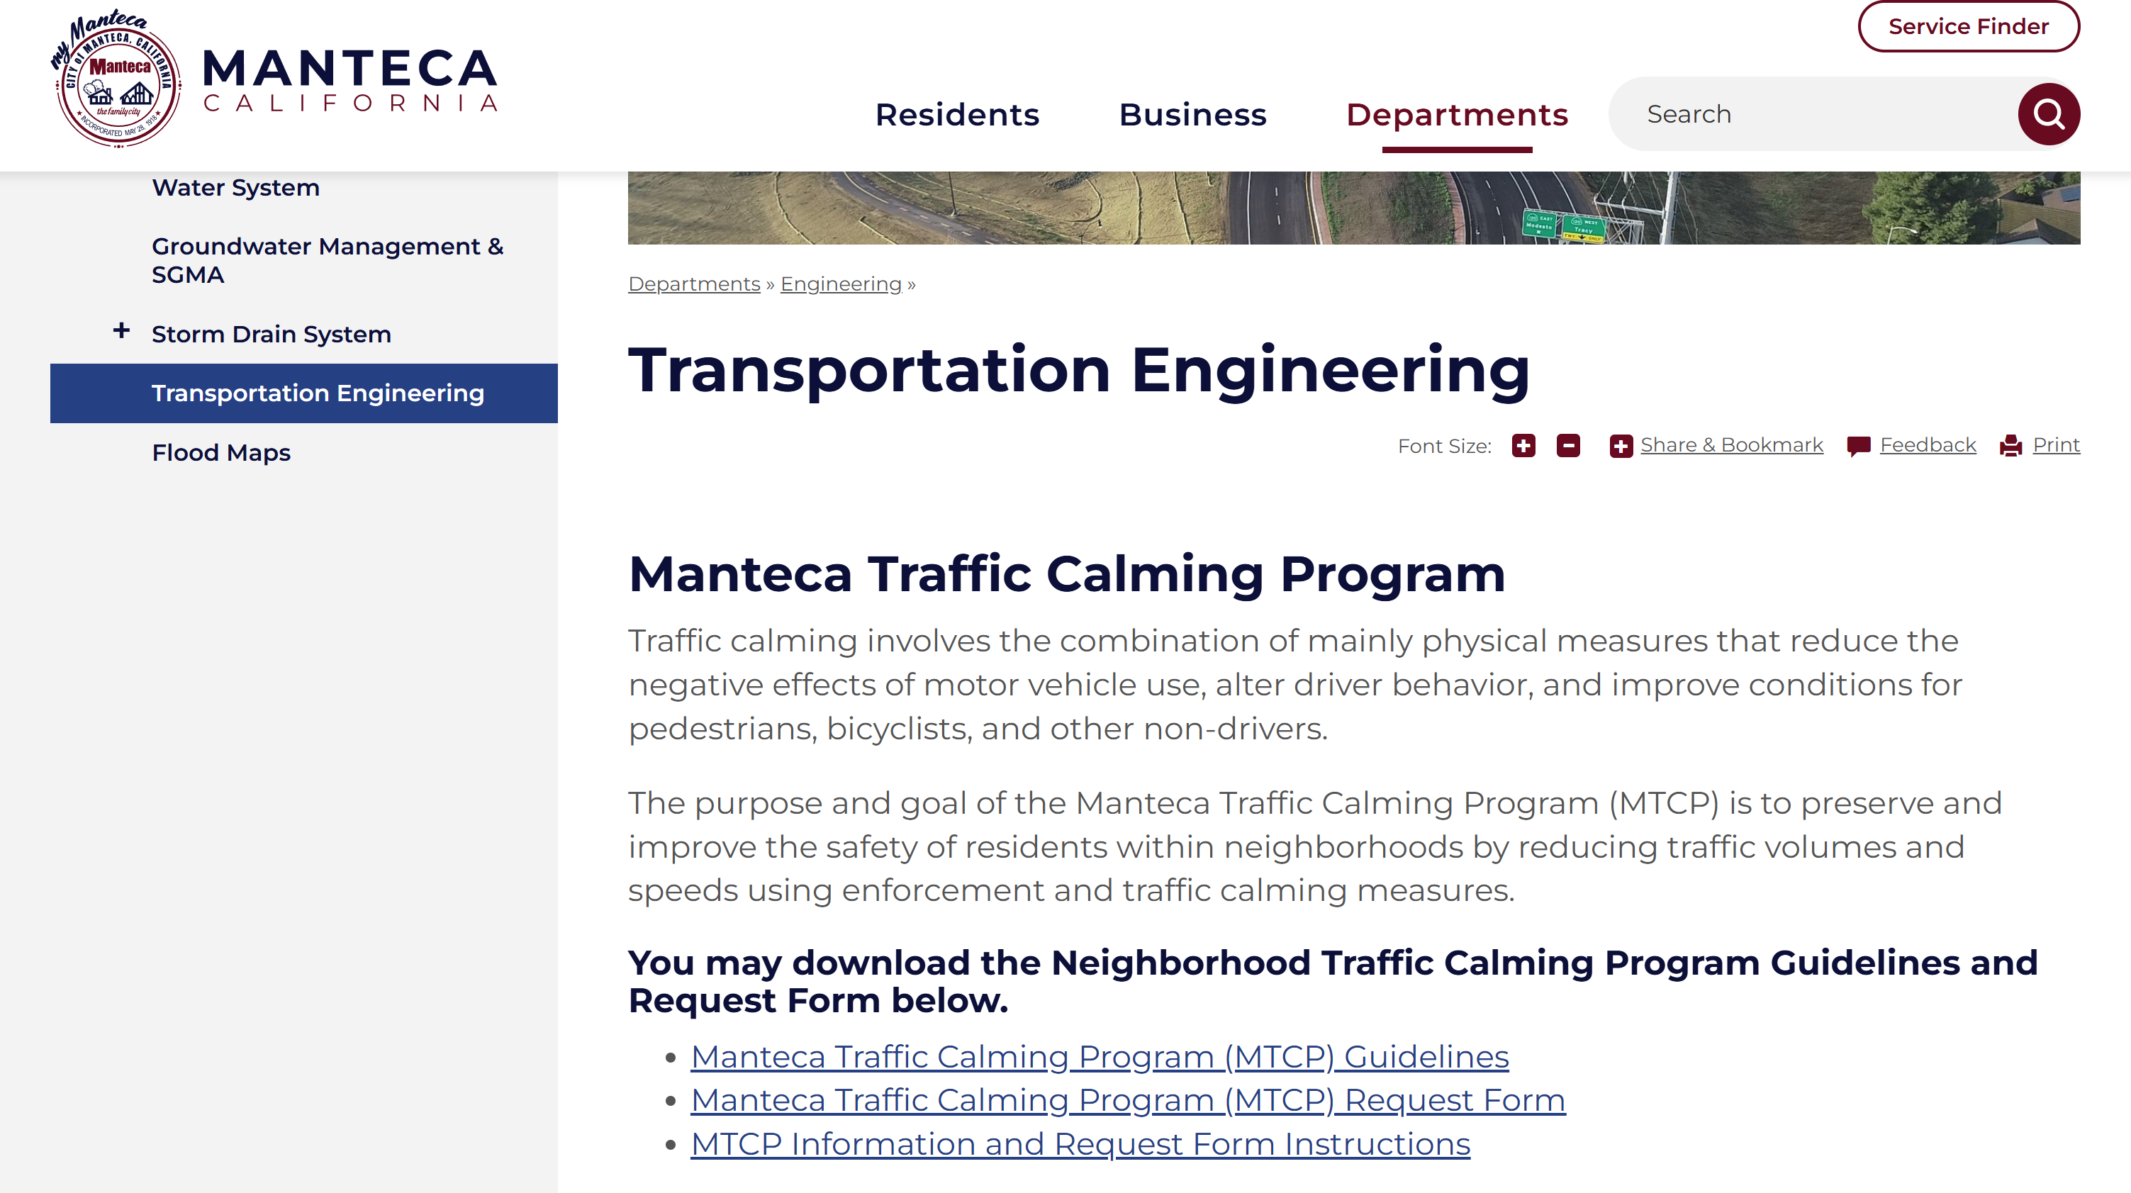
More Information
https://www.manteca.gov/departments/engineering/transportation-engineering

Slide 3
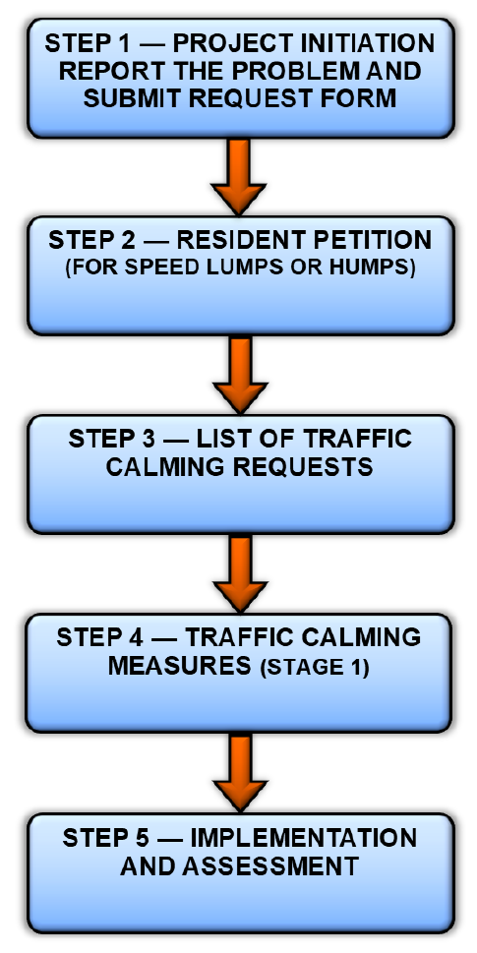
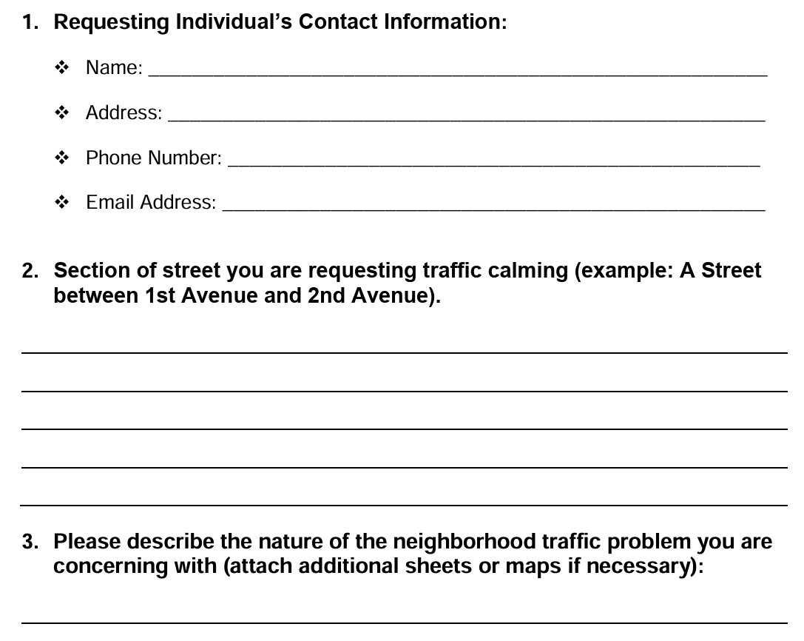
2025 Traffic Calming Program
Reduced steps to 5
Project Initiation
Initial Review

Slide 4
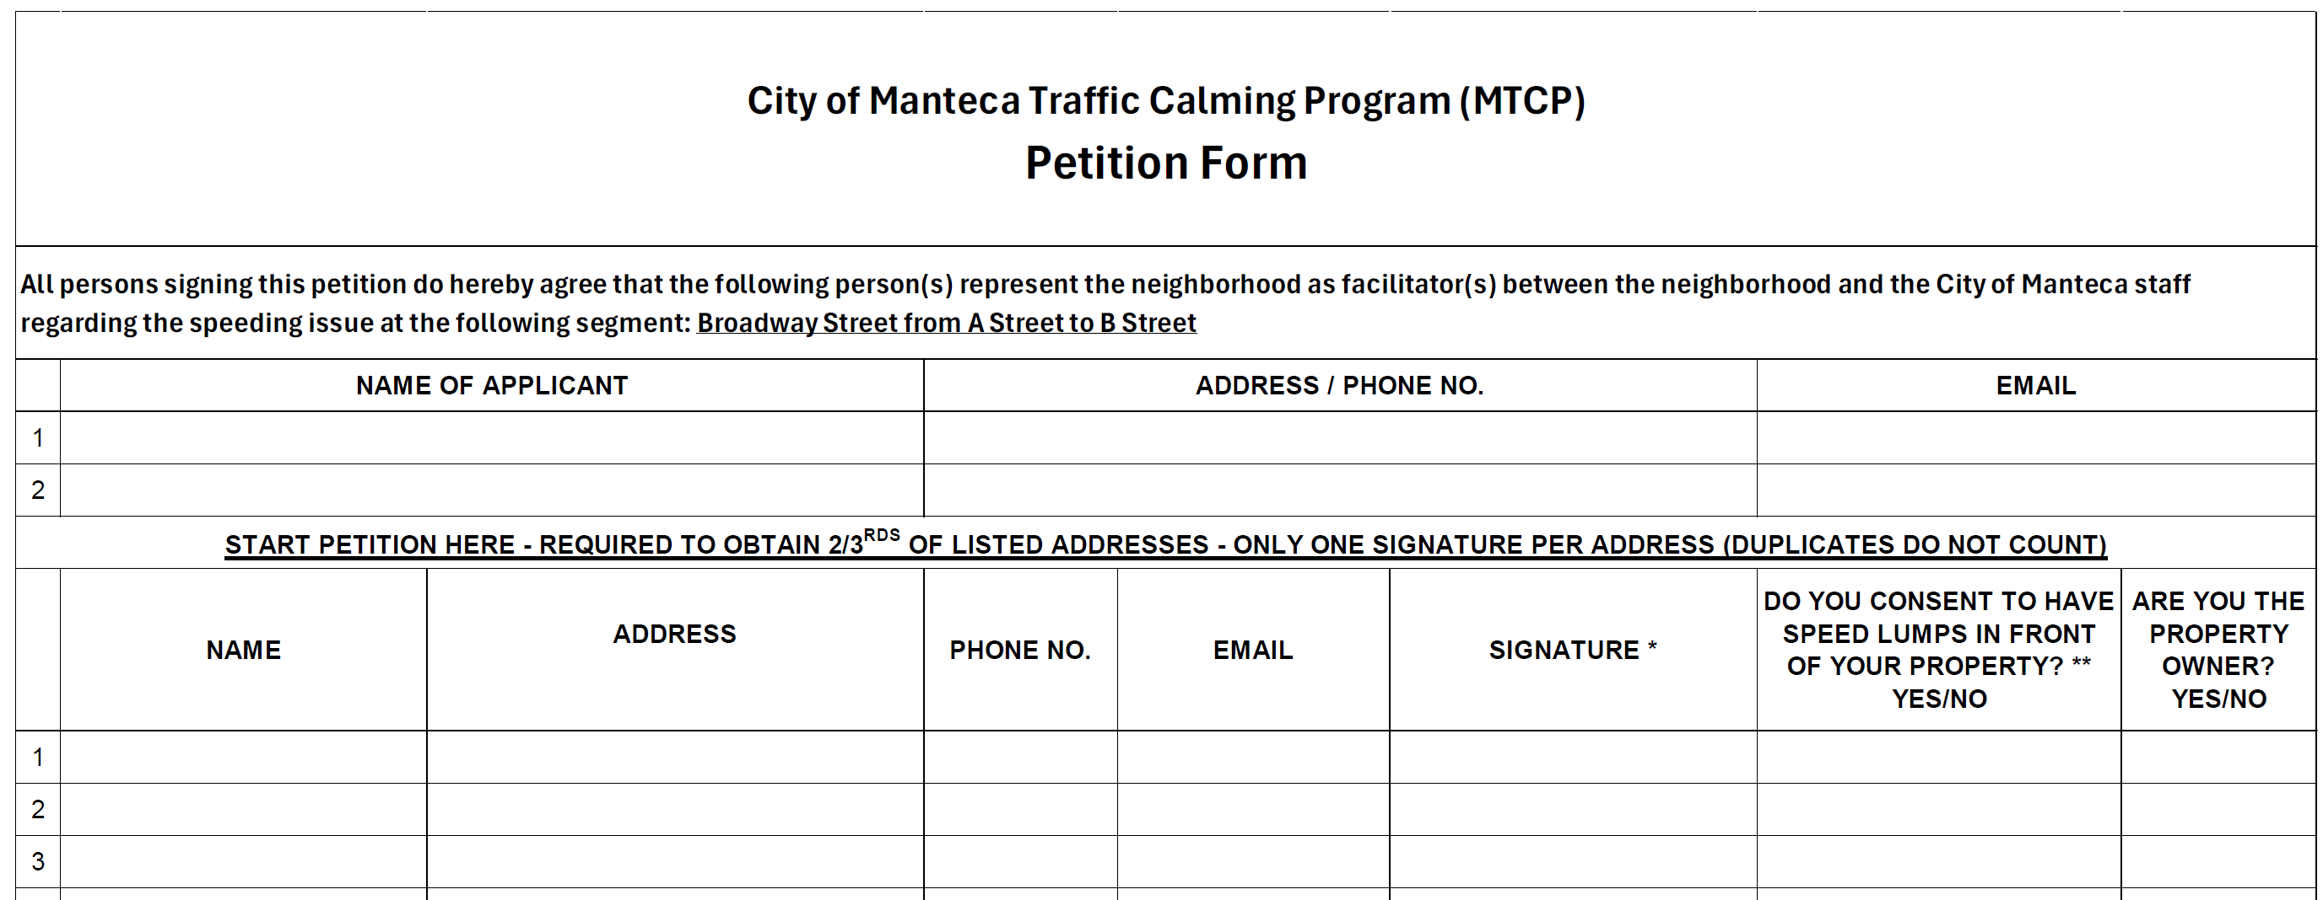
2025 Traffic Calming Program
Reduced steps to 5
Collect information upfront
Engineering Analysis

Slide 5
THANK YOU!

