Slide 1

Climate Careers
City of Manteca
City Council Meeting
Presented By: Gustavo Garcia
Notes:
Cindy

Slide 2
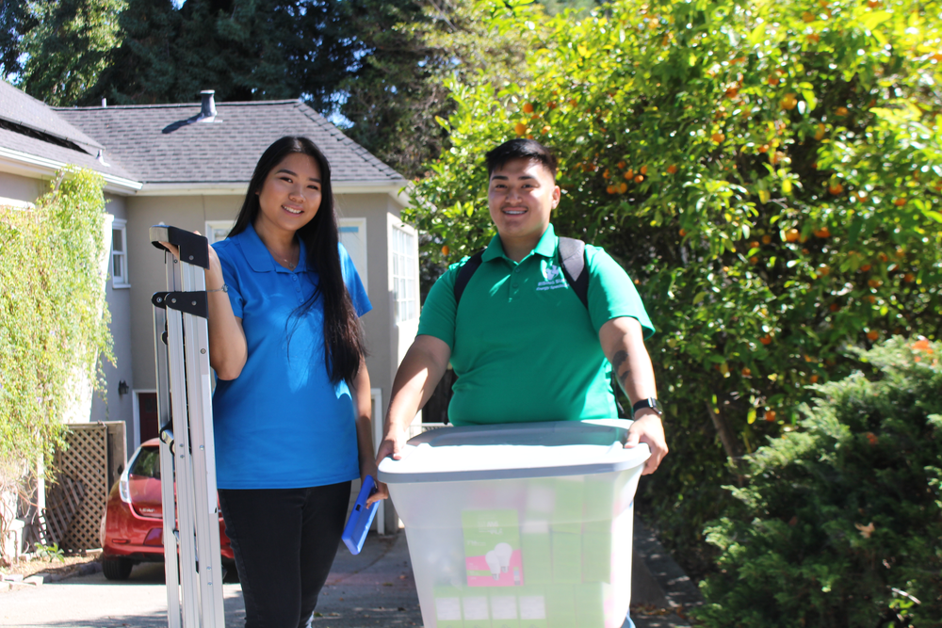




About Us
Rising Sun Center for Opportunity is a premier workforce development and community resilience non-profit serving the Bay Area and Central California (San Joaquin, Madera, and Merced counties). Headquarters in Oakland and Stockton California. With 33 full-time employees to date, and growing!
Our Mission
Building career pathways for economic equity and climate resilience.
Our Programs
Opportunity Build, a pre-apprenticeship job training program for adults
Climate Careers, a youth program that offers residential energy efficiency installations
Notes:
Cindy

Slide 3


Climate Careers: Youth Program
Workforce development program giving low-income young people (15-24) meaningful employment through no-cost energy & water saving delivery services to homes in the Bay
Area and Central Valley
Youth Development
  Job Training & Preparation
  Green Jobs Careers Pathway Exploration
  Financial Management
  Professional skill building
  Leadership & Civic Education
  Alumni Support
Energy & Water Services
  Green House Calls
  Energy Eﬃciency Kits
  Community Resources & Referrals
  Energy & Water Use Coaching
  Electriﬁcation Education
  Home Air Quality
2,000 youth employed since 2000
60,000+ homes served since 2000
Notes:
Emily
Two fold offerings- benefits for youth and for Bay Area residents
Formerly known as CYES, California Youth Energy Services
As a youth, what should you expect to gain from this program?
‹#›

Slide 4

TCC, and Regional Energy Network (REN) Contracts
Climate Careers Funding
Local Municipalities
Grants & Foundations
CLIMATE CAREERS
Individual Donors
Copyright © 2018 Rising Sun. All rights reserved.
Notes:
Cindy
main contract for the bay area is bayREN multi-year contract almost at its entirety. Small contributions to our budget including individual donors. We have a grants development departments that applies to grants

Slide 5


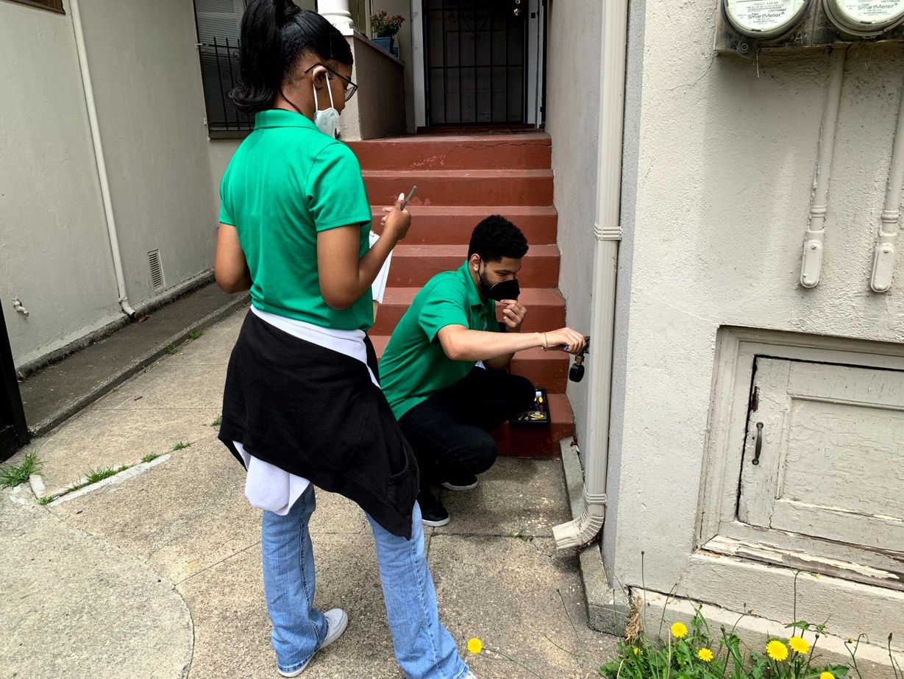
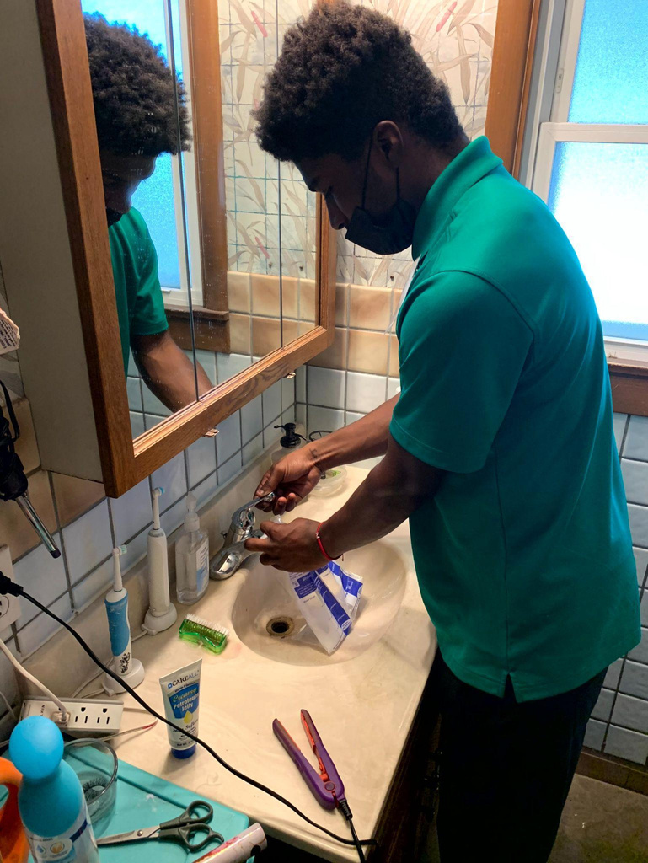


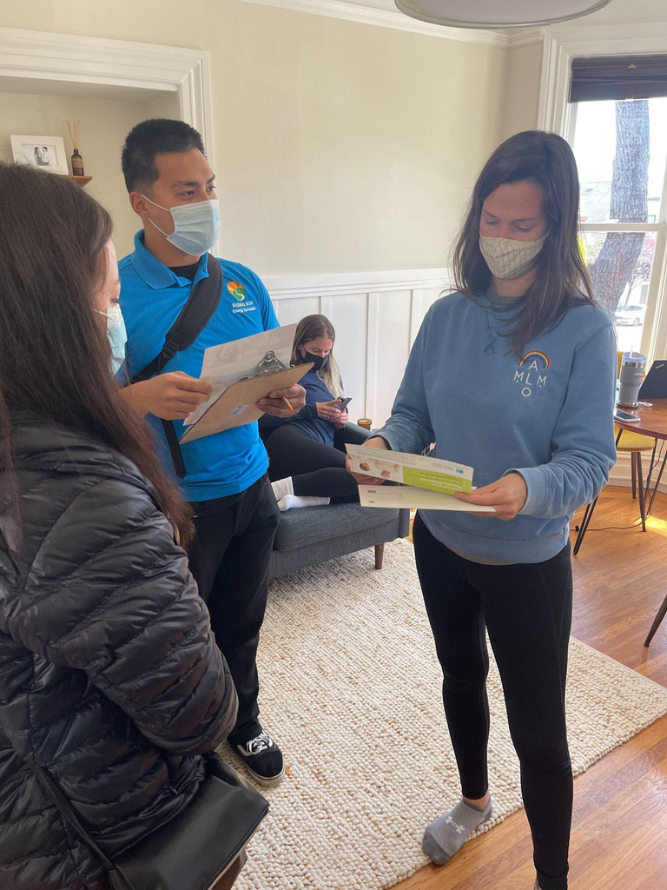




IN-PERSON PROGRAM
June - August (San Joaquin County sites in Stockton and Manteca)
Step 2
Step 1
Step 3
Basic assessment of the homes’ energy and water use
Customer Pledge and Resource
Sharing
Installation of eﬃciency devices
Notes:
Cindy

Slide 6





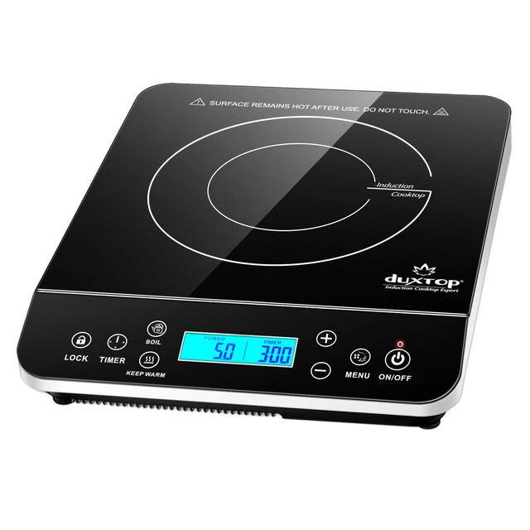




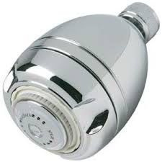










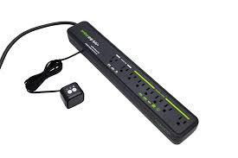

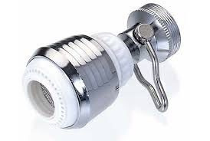





Green House Call Installations
Foam outlet insulation
gaskets
Low-ﬂow
Single burner induction
Weatherstripping tape for doors and
Smart LED bulbs
cooktop
shower heads
LED light
windows
bulbs
Induction-compatible cookware
Kitchen and bathroom sink aerators
Advanced smart power strips
Smart plugs
Energy Savings Tips Booklet
Notes:
Cindy
‹#›

Slide 7

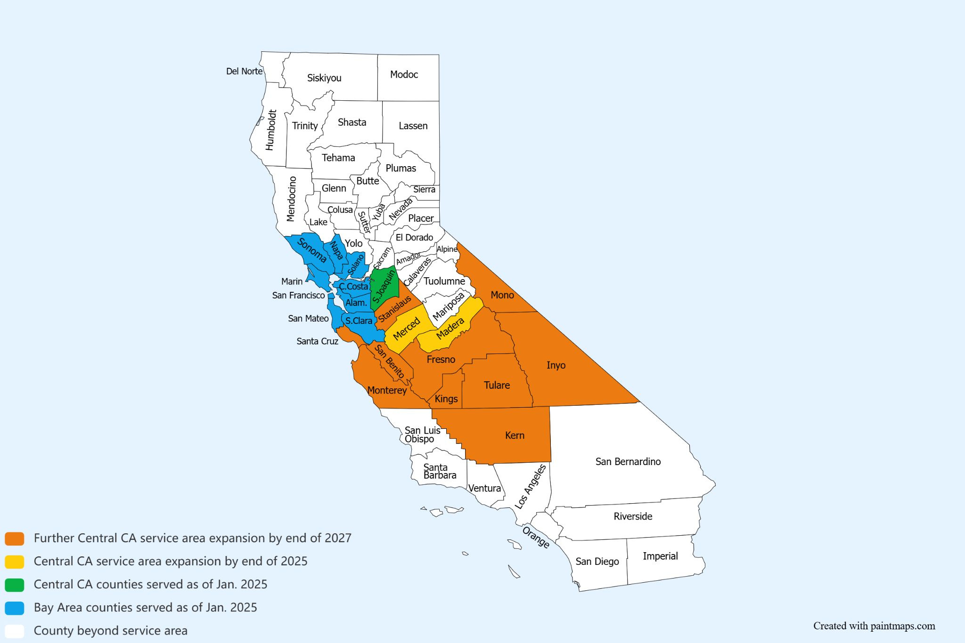



Madera County
●
Madera Fall Office
2025 Focus Areas
■Madera, Chowchilla
Merced County
●
Los Banos Fall Office
■Los Banos, Gustine, Dos Palos
San Joaquin County
●
Stockton Summer Office
■North Stockton, South Stockton
(TCC), Collerville, Thornton, Woodbridge, Lockerford, Acampo
●
Manteca Summer Office
■Manteca, Linden, French Camp,
Farmington
○
Notes:
Emily
Installed energy and water saving measures in Daly City in the past 5 years
Savings add up
Zooming out, we’ve serviced 1065 households in San Mateo in the past yeaers
Looking at our larger program
‹#›

Slide 8
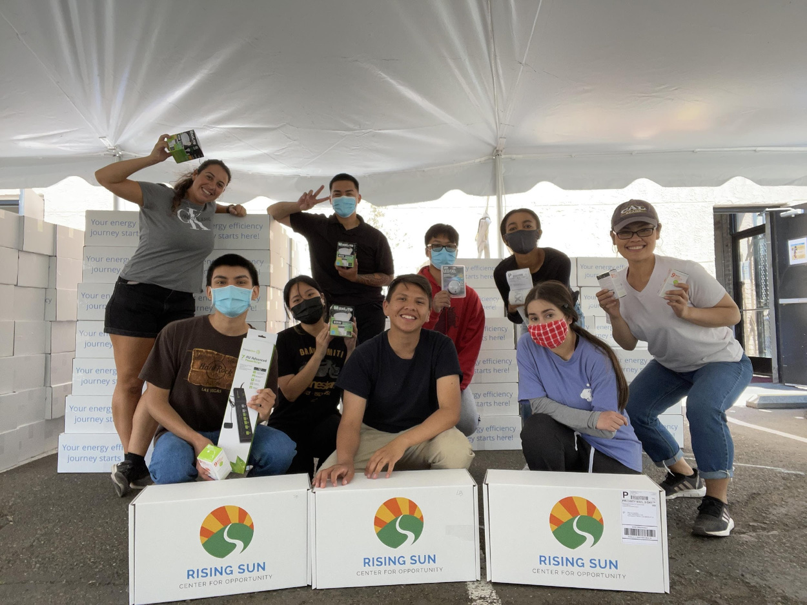
Youth Impact
Site Office Structures:
  1 Site Program Managers
  1 Summer Program Managers
  1 Youth Development Specialists
  8 Energy Specialist and Driver(s)
  1 Leaders in Field Training
  Hiring in Stockton and Manteca
Youth Hired to date:
  Over 2,000 youth employed since 2000
For all inquiries regarding Climate Careers Recruitment please contact:
  Gustavo Garcia - garcia@risingsunopp.org
Notes:
Emily
Case managers who work with system-impacted youth

Slide 9
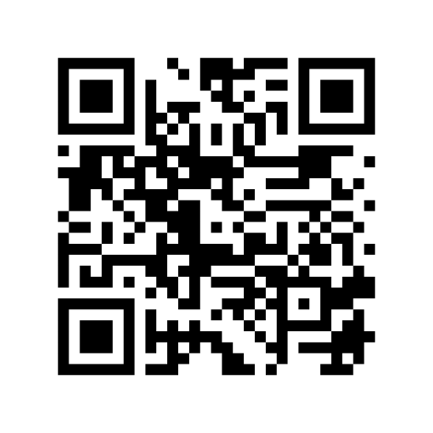
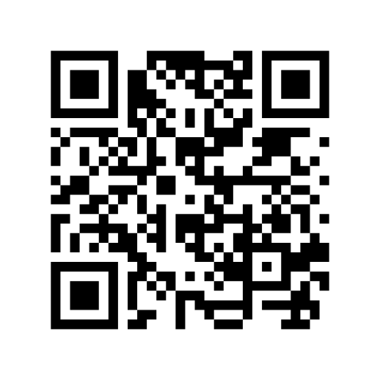
Interested in a Position with Climate Careers?
Interested in a Green House Call?
Scan this QR code to take a short 20 minute survey and become more sustainable today!
Scan this QR code to check out our Jobs Page at Rising Sun Center for Opportunity

Slide 10
Questions?
Notes:
Cindy and Emily

